Slide 1
NLP Tutorial A Case Study
Berke Dilekoğlu

Slide 2
Outline
Part A: Category Prediction by using IMDB data
Explore Data and Problem
Preprocessing
Vector Representations (Tf-idf)
Train/Test
Part B: Clustering
Explore problem
Preprocessing
Embeddings
Finding clusters

Slide 3
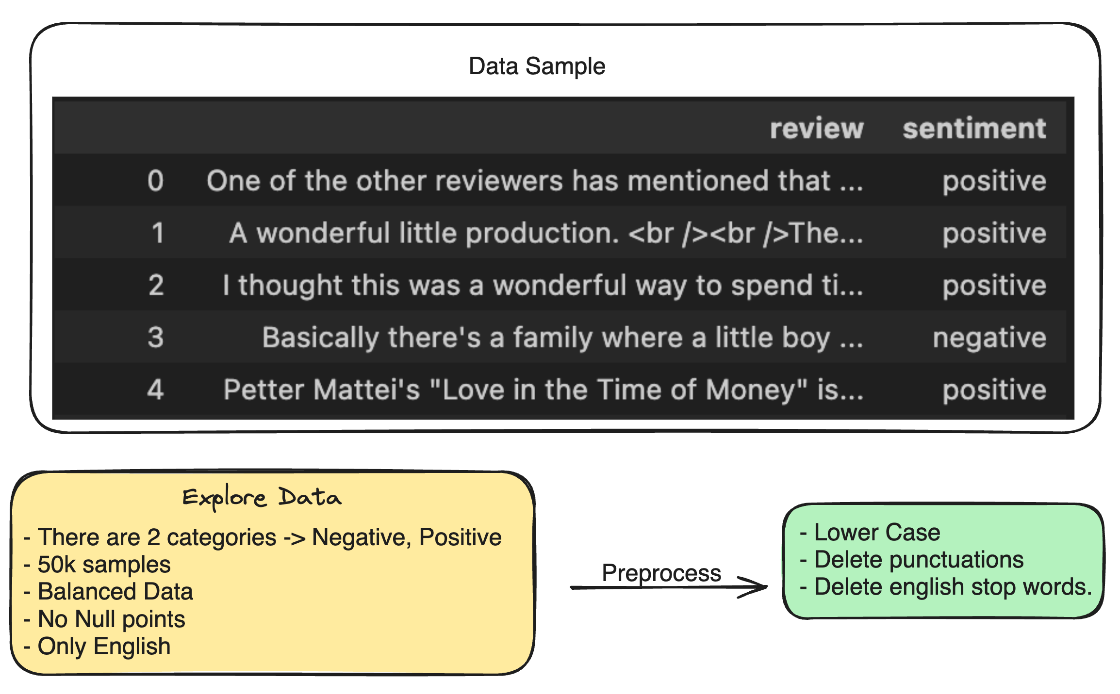
Explore Data: Category prediction by using IMDB data

Slide 4
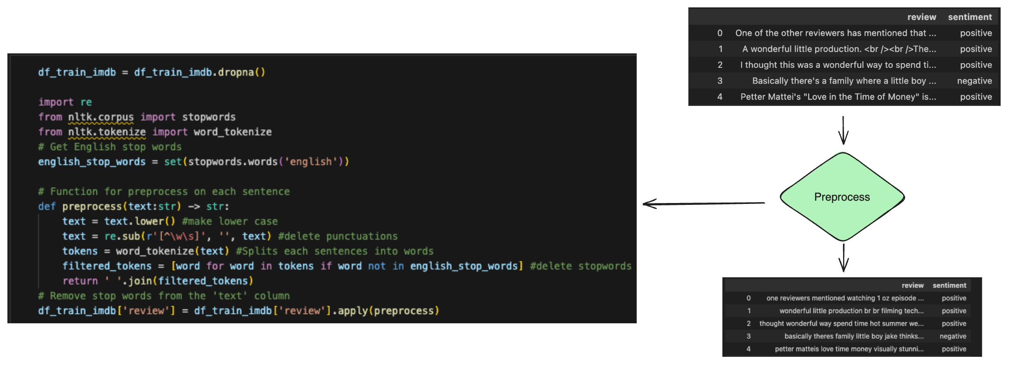
Preprocess: Category prediction by using IMDB data
Nltk and Regular Expression

Slide 5
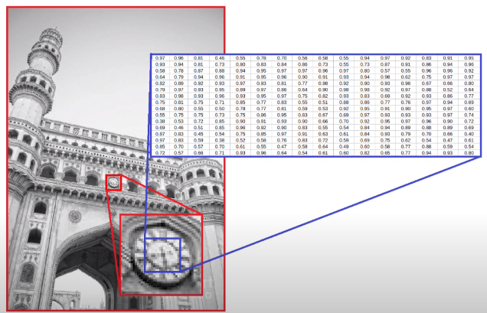
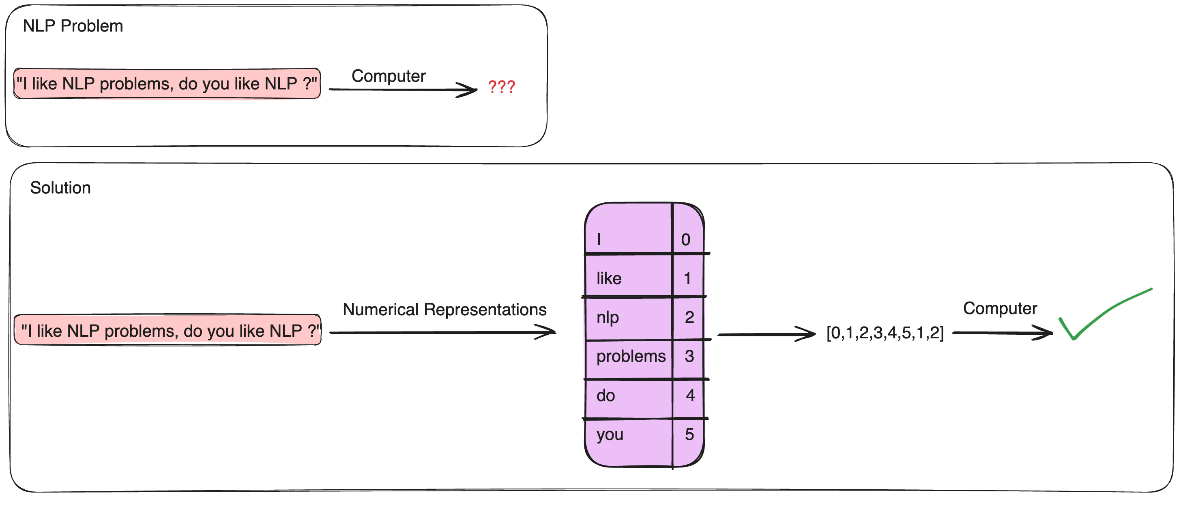
Represents Text Data
Computer Vision
NLP
https://towardsdatascience.com/computer-vision-image-formation-and-representation-a63e348e16b4

Slide 6
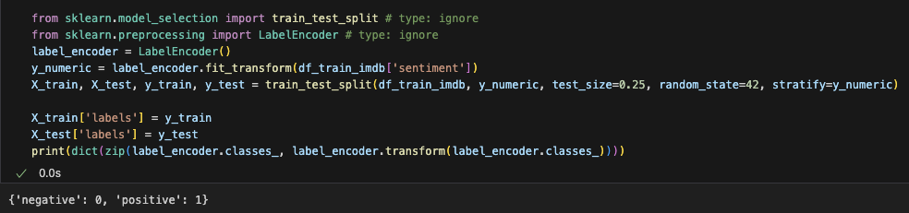
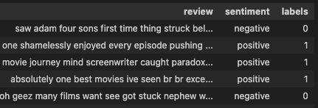
Convert Labels to Numerical Representations

Slide 7
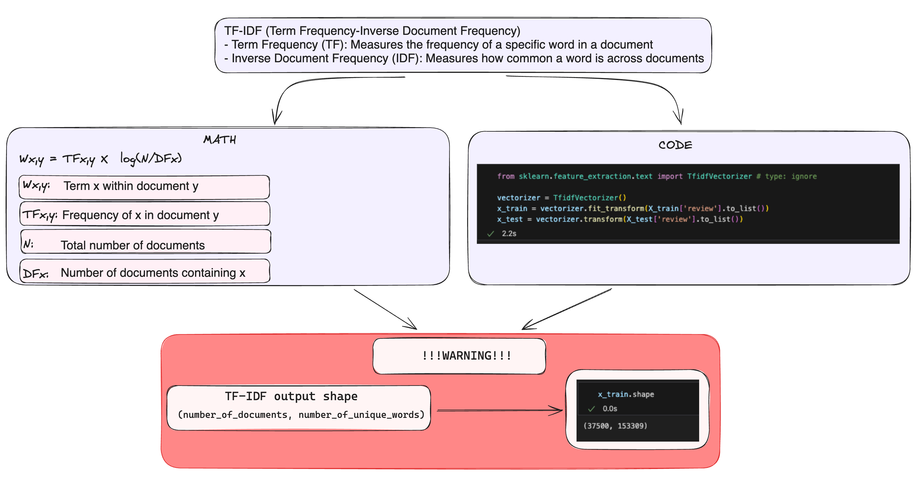
Vectorize Data: Category prediction by using IMDB data

Slide 8
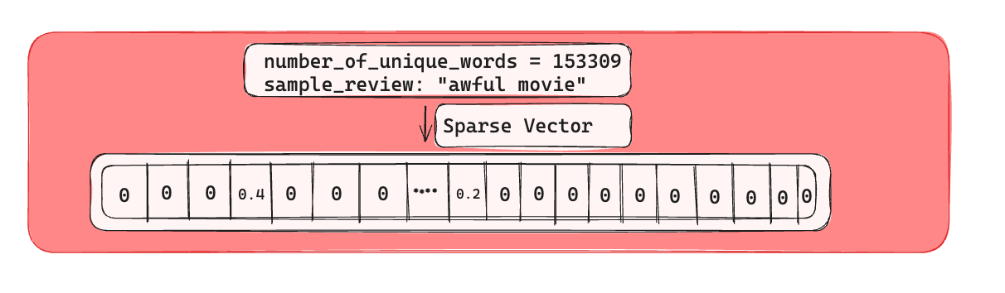
Sparse Vector

Slide 9
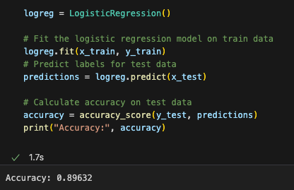
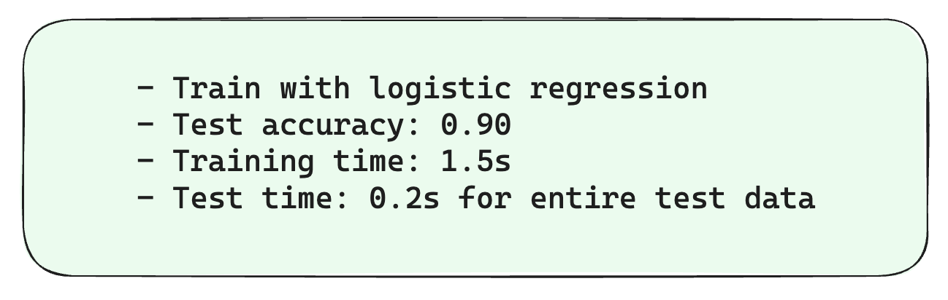
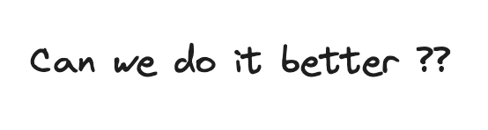
Train and Test Performance

Slide 10

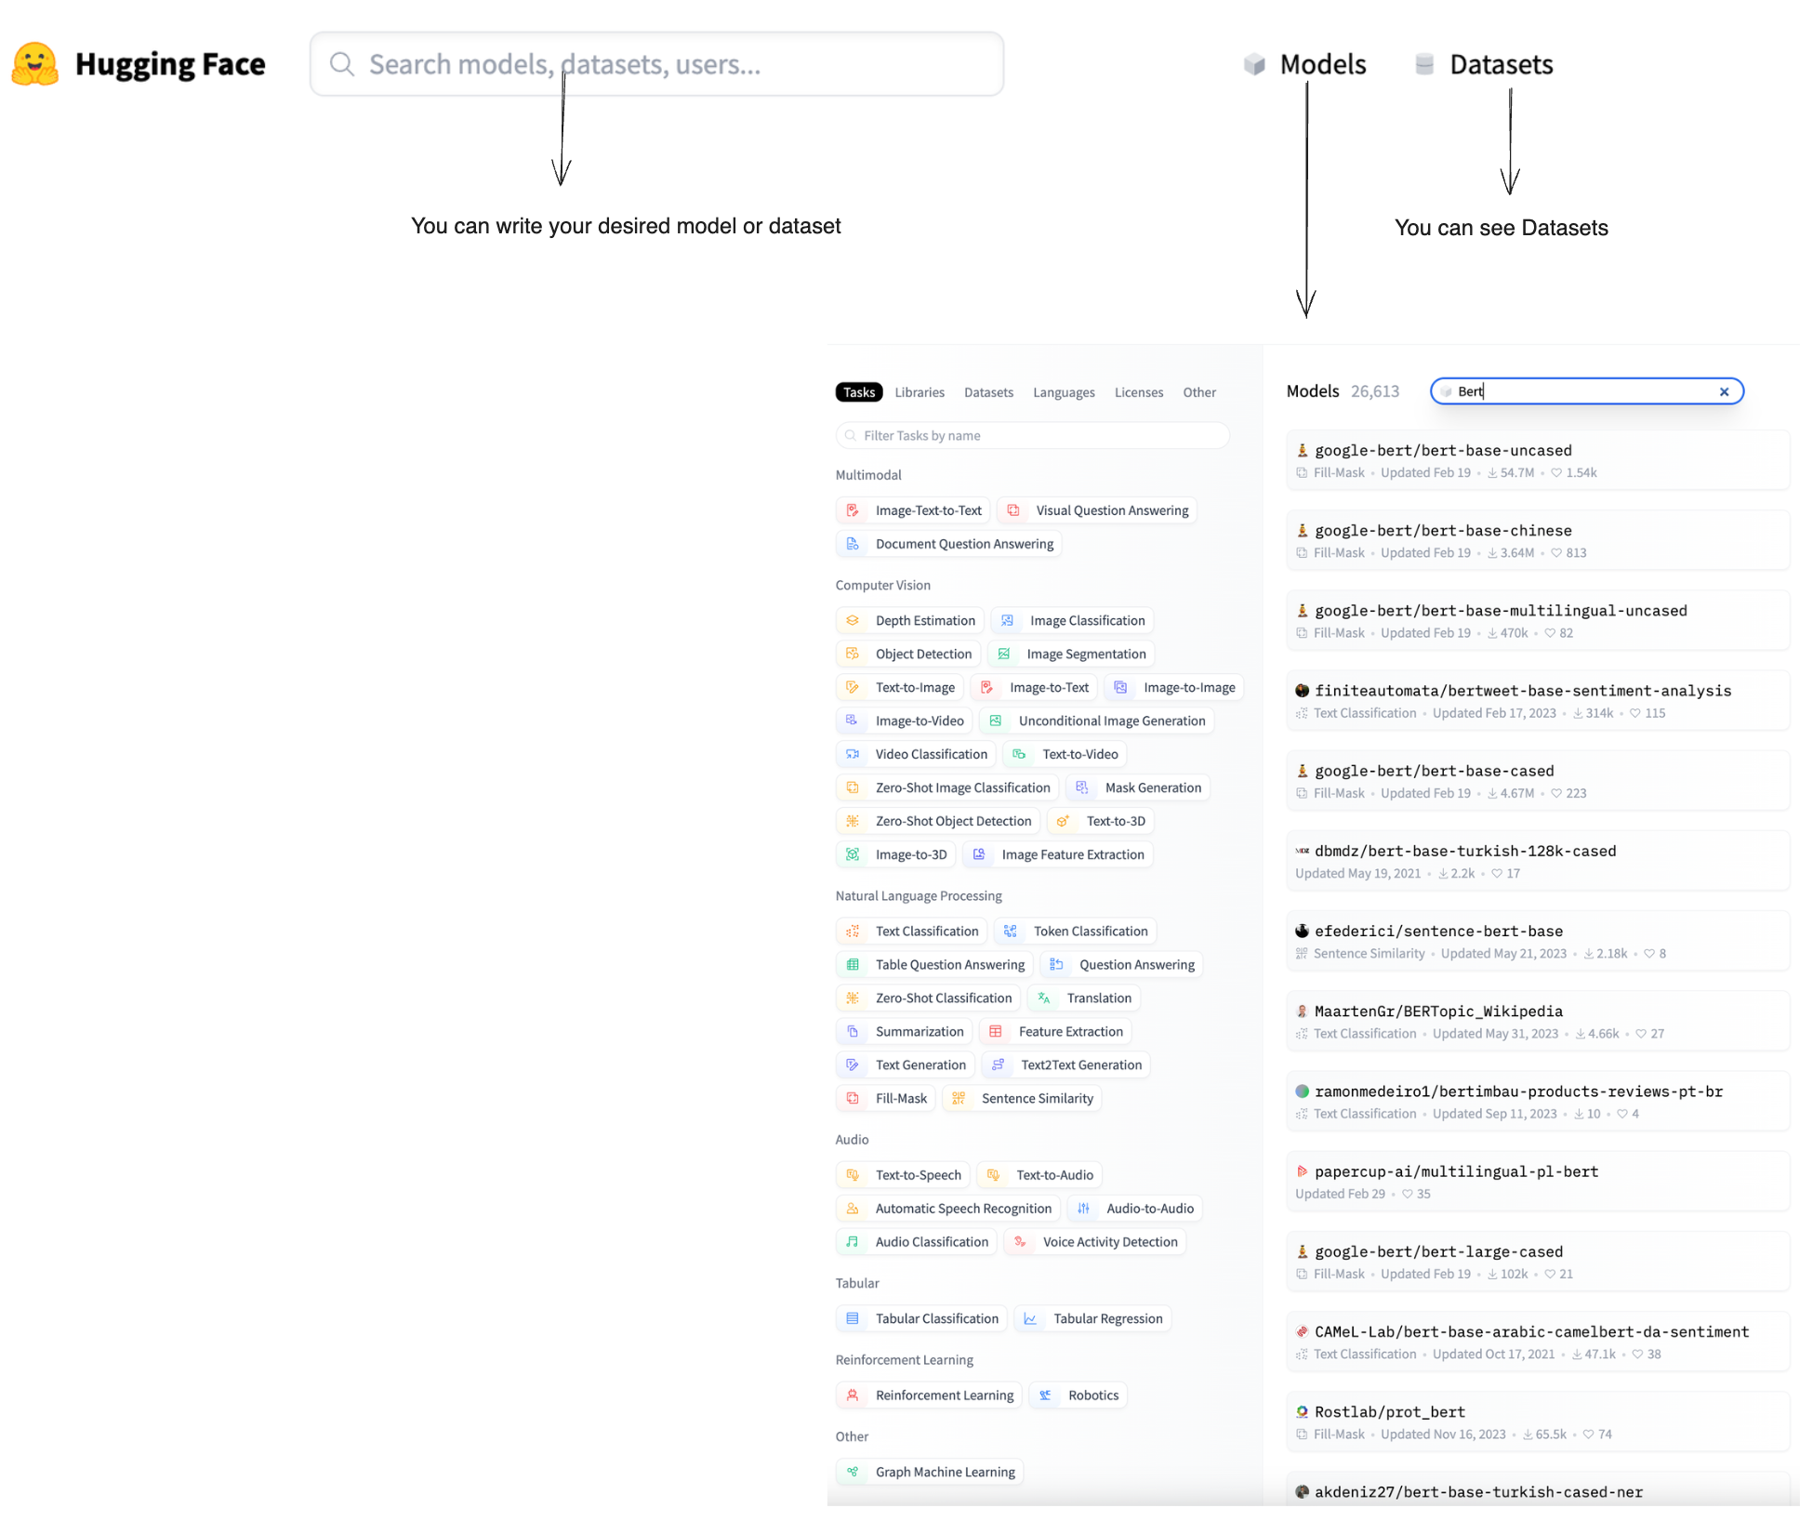
SOTA -> Transformers
https://huggingface.co/

Slide 11
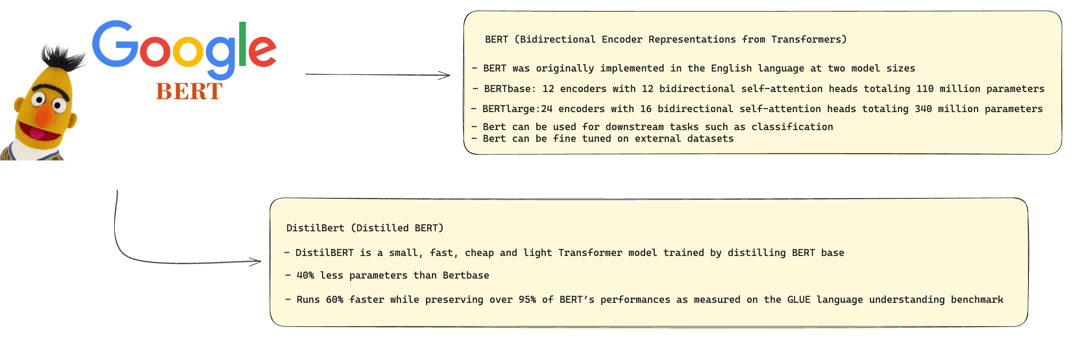
Distilbert
https://huggingface.co/google-bert/bert-base-uncased

Slide 12
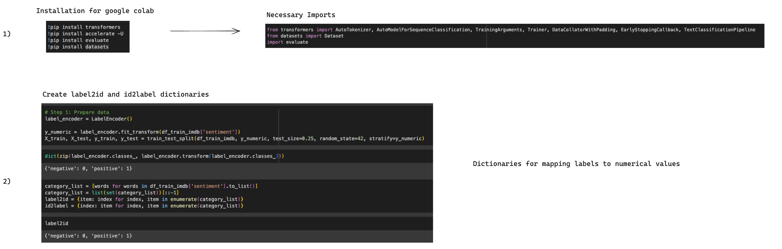
Fine Tune Distilbert

Slide 13
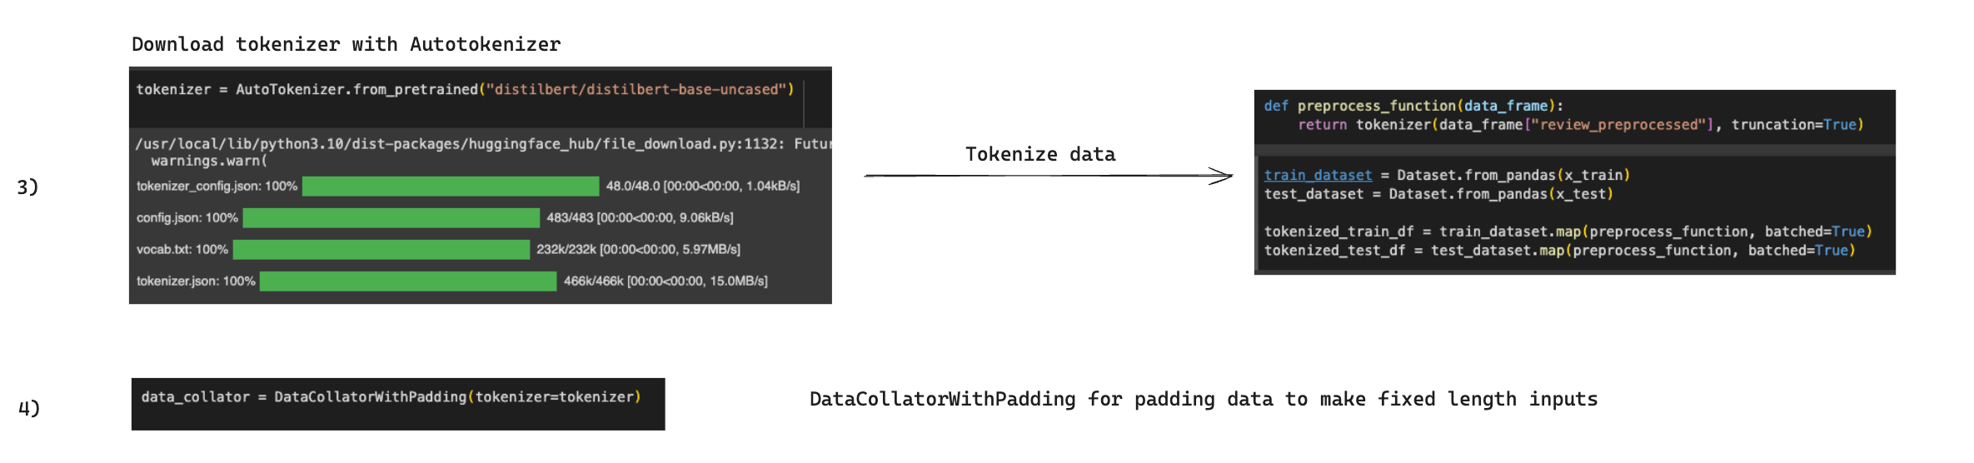
Fine Tune Distilbert

Slide 14
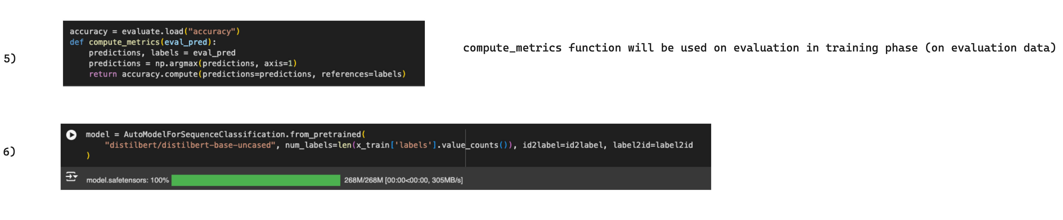
Fine Tune Distilbert

Slide 15
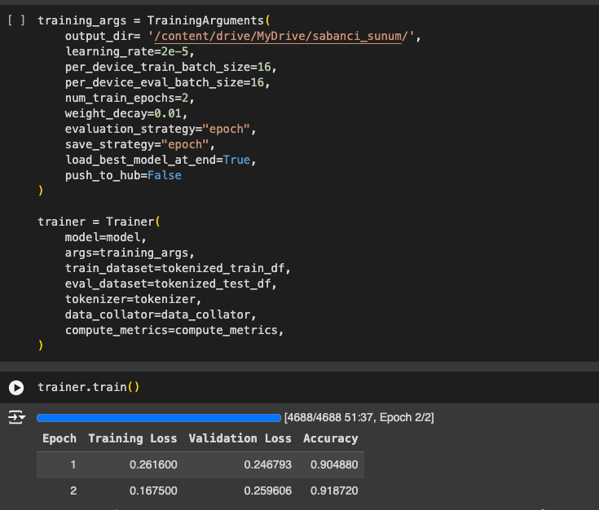
Tune Distilbert

Slide 16
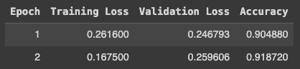
Distilbert vs Logistic Regression
Logistic Regression
Distilbert

Slide 17
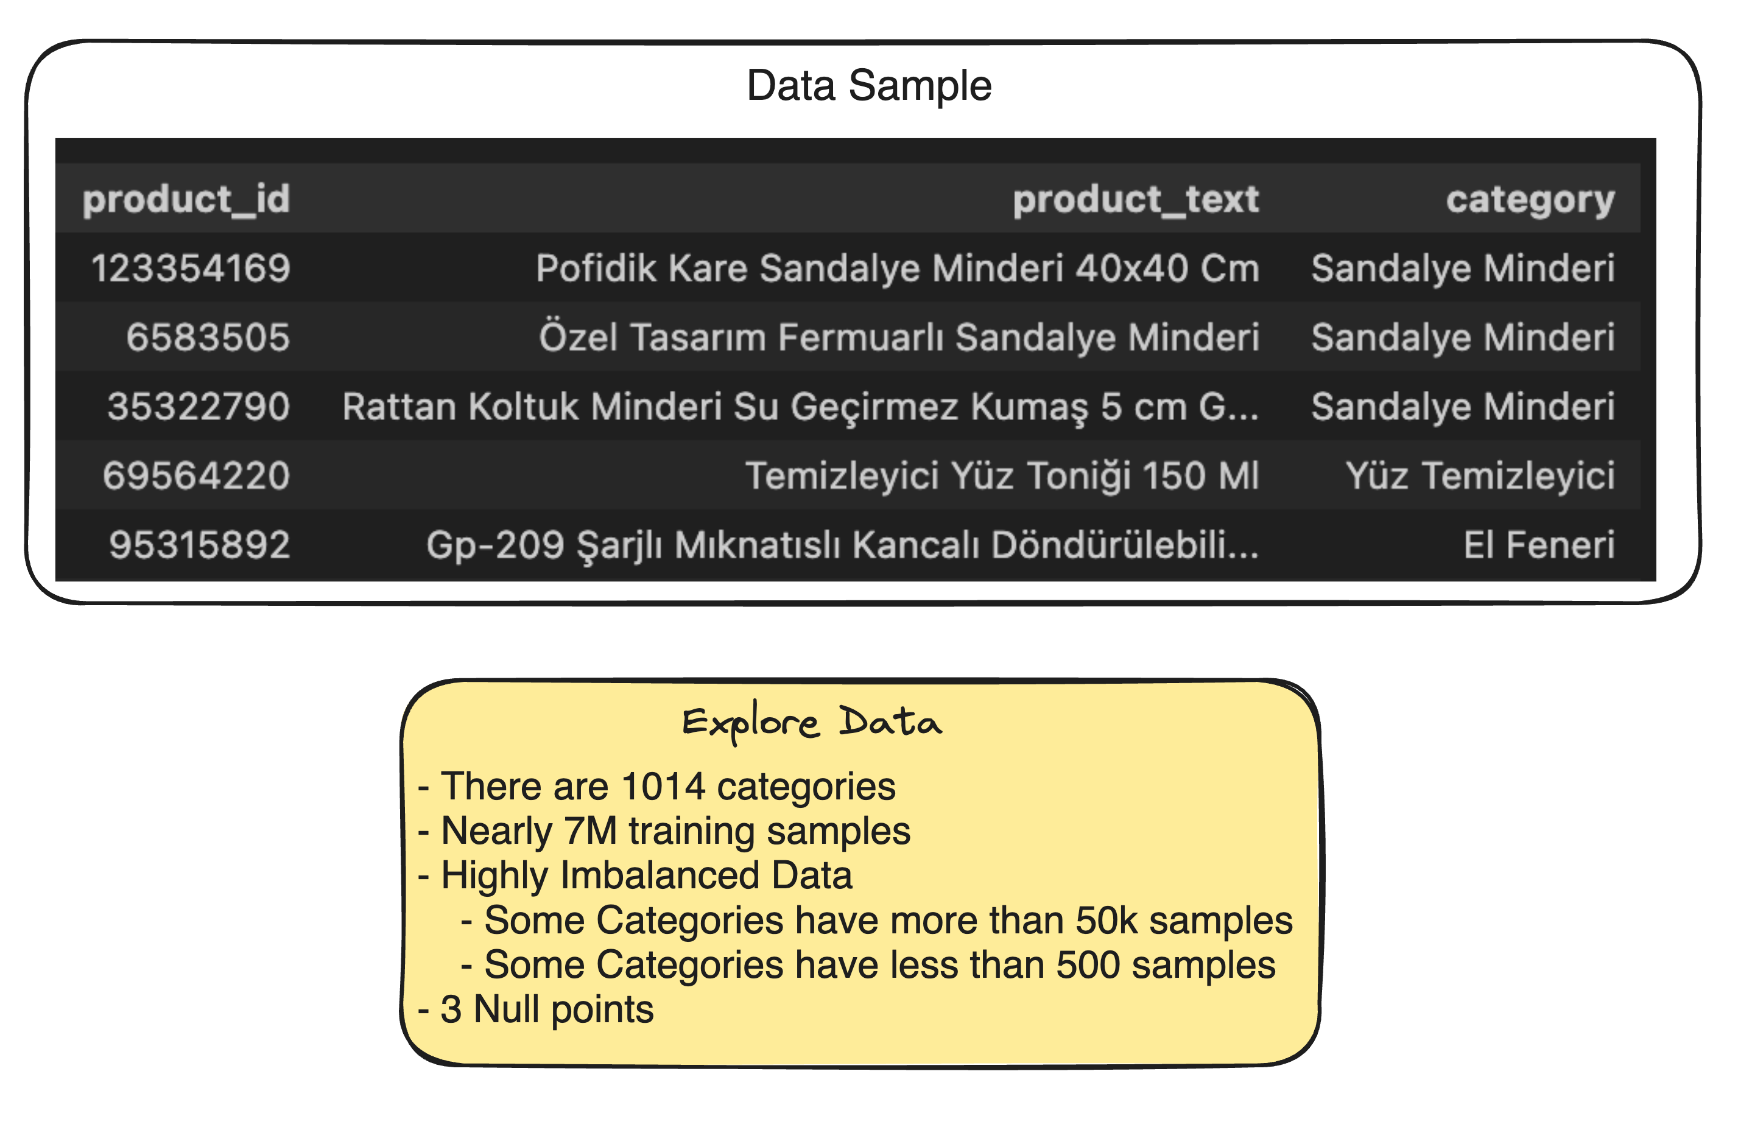
Case 2: Find 5 category

Slide 18
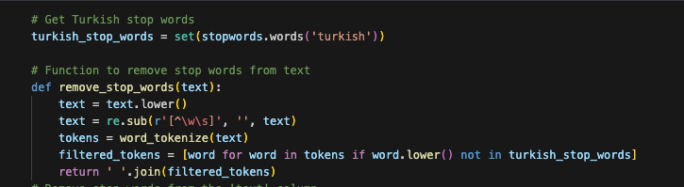
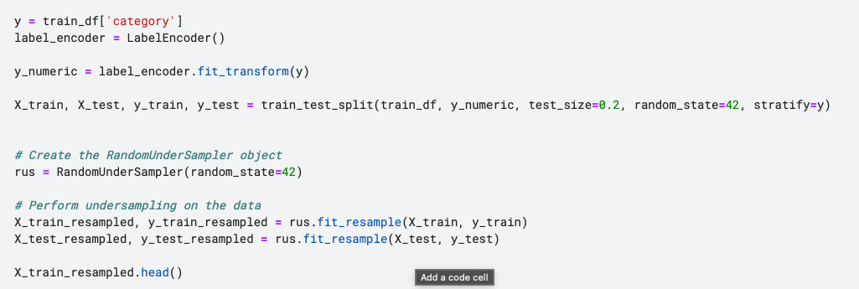
Preprocessing
Same as before
Under sampling

Slide 19
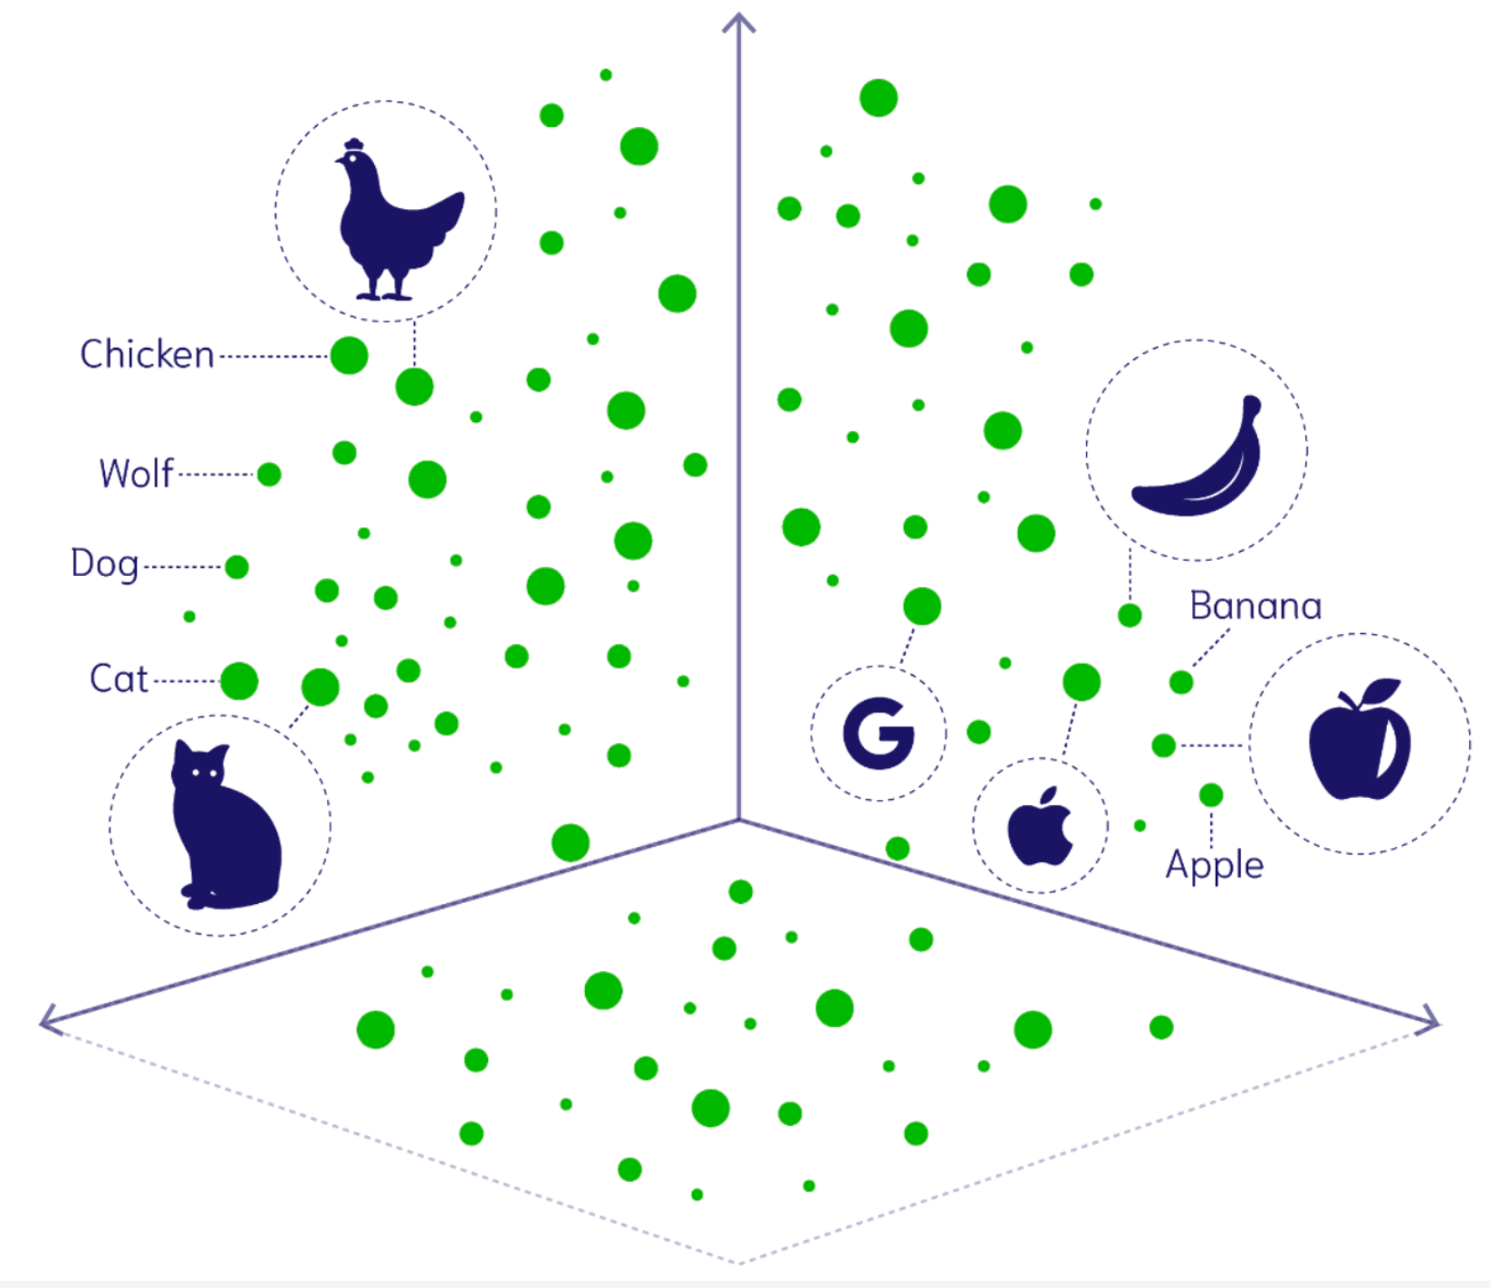
We need mathematical representations
After under sampling we have nearly 110k training samples
Not feasible for Tf-Idf vectorization
We need Embeddings
Bert embeddings are 768 dim
Not sparse
https://weaviate.io/blog/multimodal-models

Slide 20
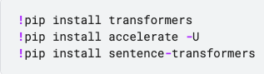
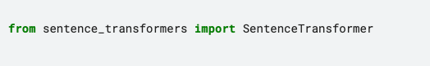
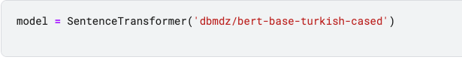
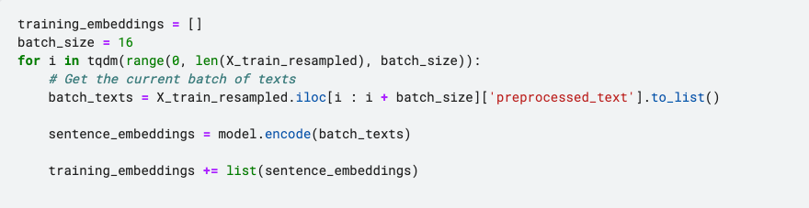
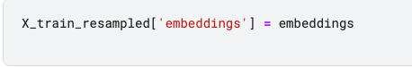
How can we find Bert Embeddings
Just install and import libs
Download bert-base-turkish-cased
Find Embeddings
Save them into column

Slide 21
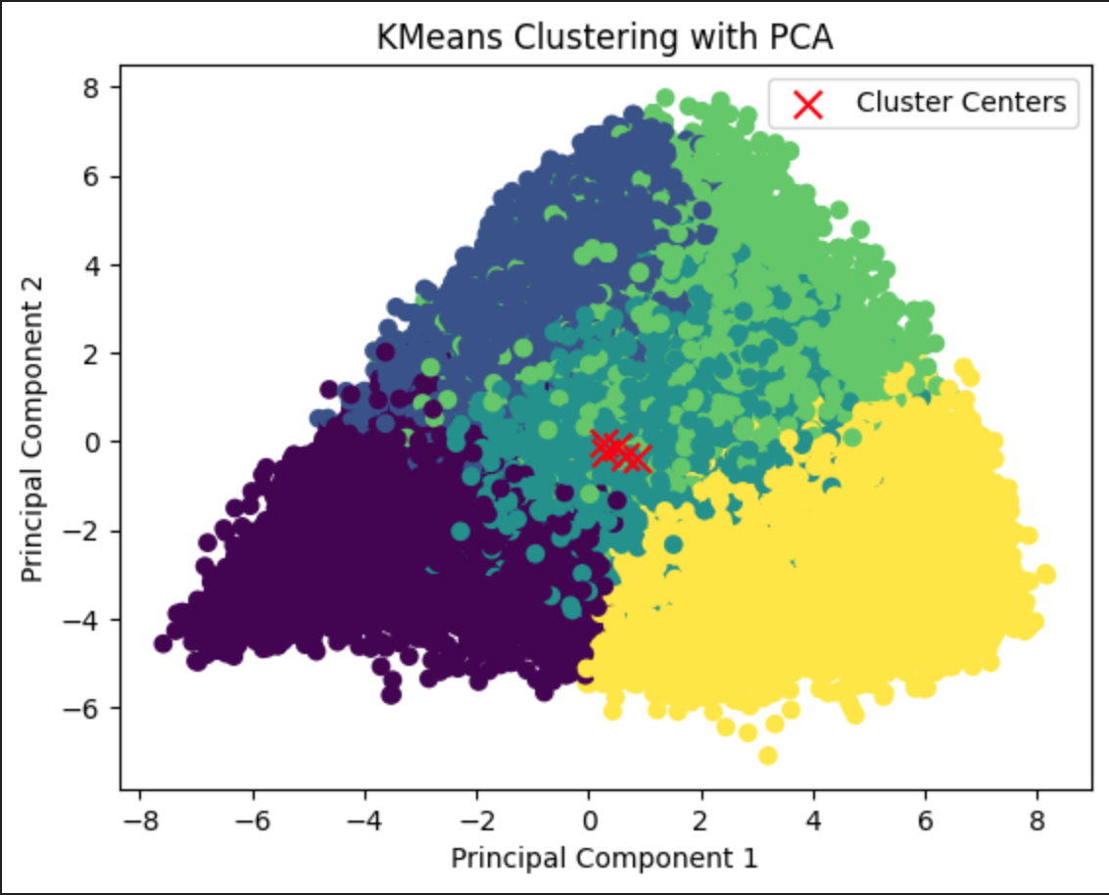
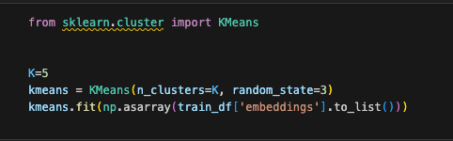
K-Means
PCA was used to reduce dimensionality
We can saw 5 clusters on figure
It gives an idea but 2D plot is not the best choice for visualization of data points

Slide 22
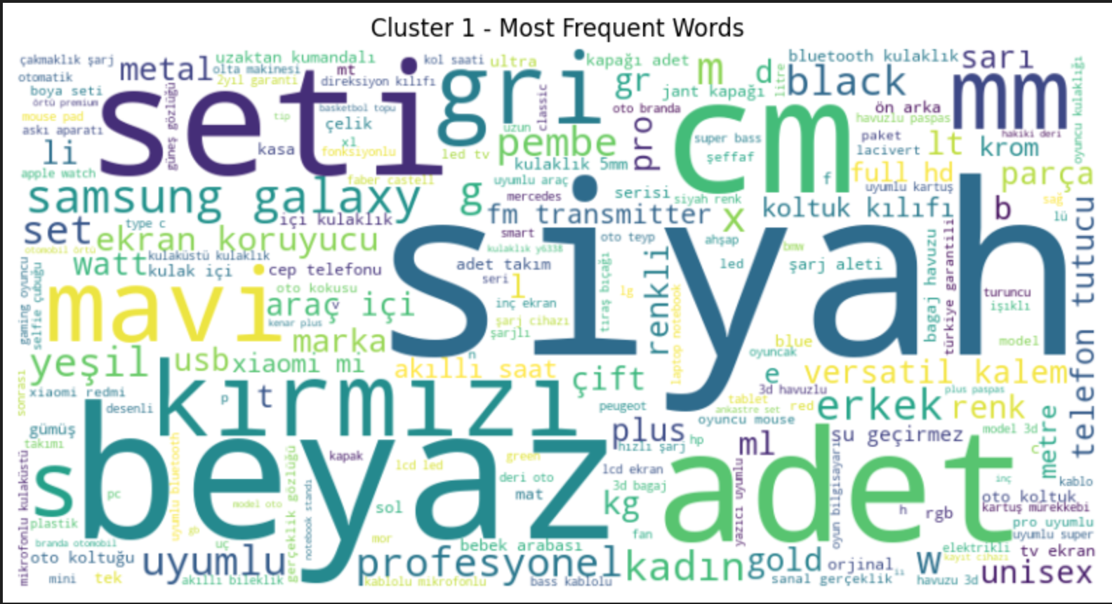
Cluster Examination
Tf-idf top 20:
uyumlu, siyah, seti, oto, mm, 10, usb, pro, bluetooth, adet, ekran, beyaz, kalem, led, makinesi, 12, şarj, erkek, model, set
My category idea for cluster 1: Elektronik

Slide 23
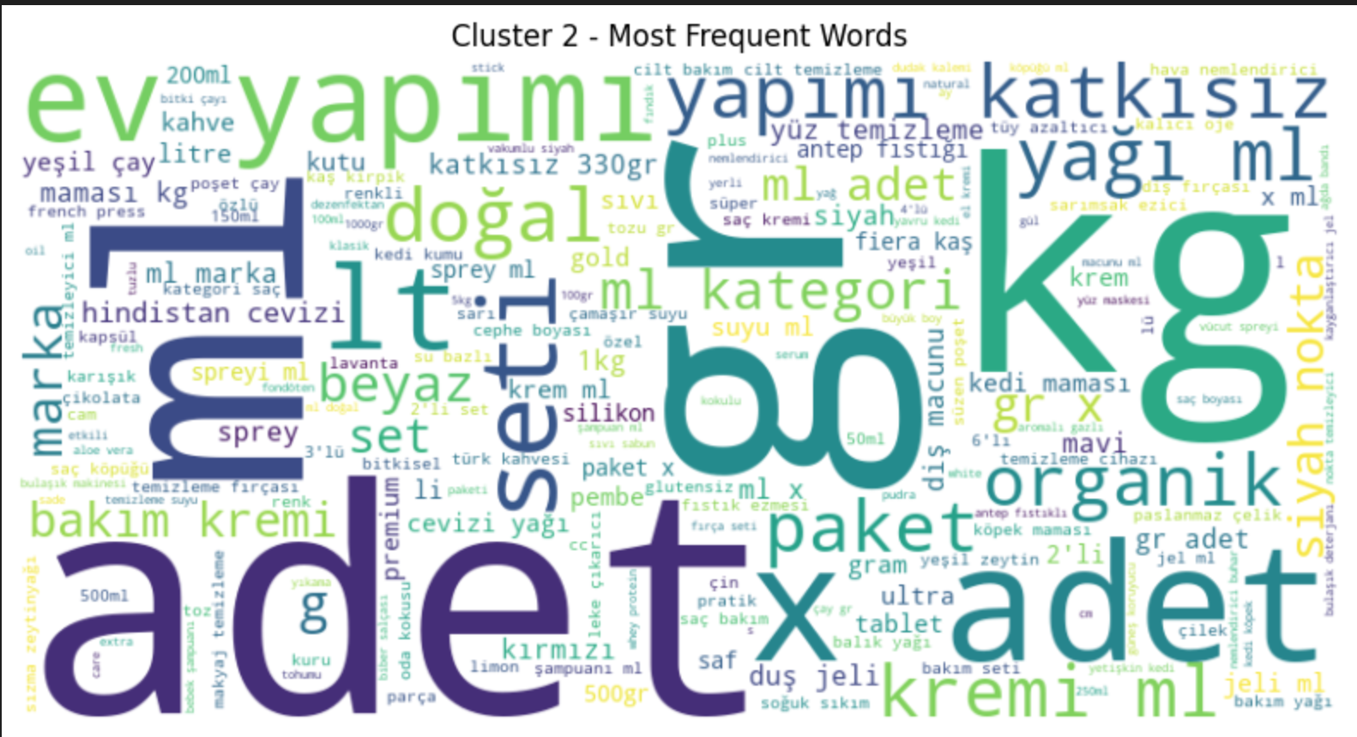
Cluster Examination
Tf-idf top 20:
ml, gr, adet, kg, 500, yağı, 100, saç, bakım, kremi, 50, 250, paket, lt, 200, temizleme, doğal, li, yüz, 150
My category idea for cluster 2: Bakım/Kozmetik

Slide 24
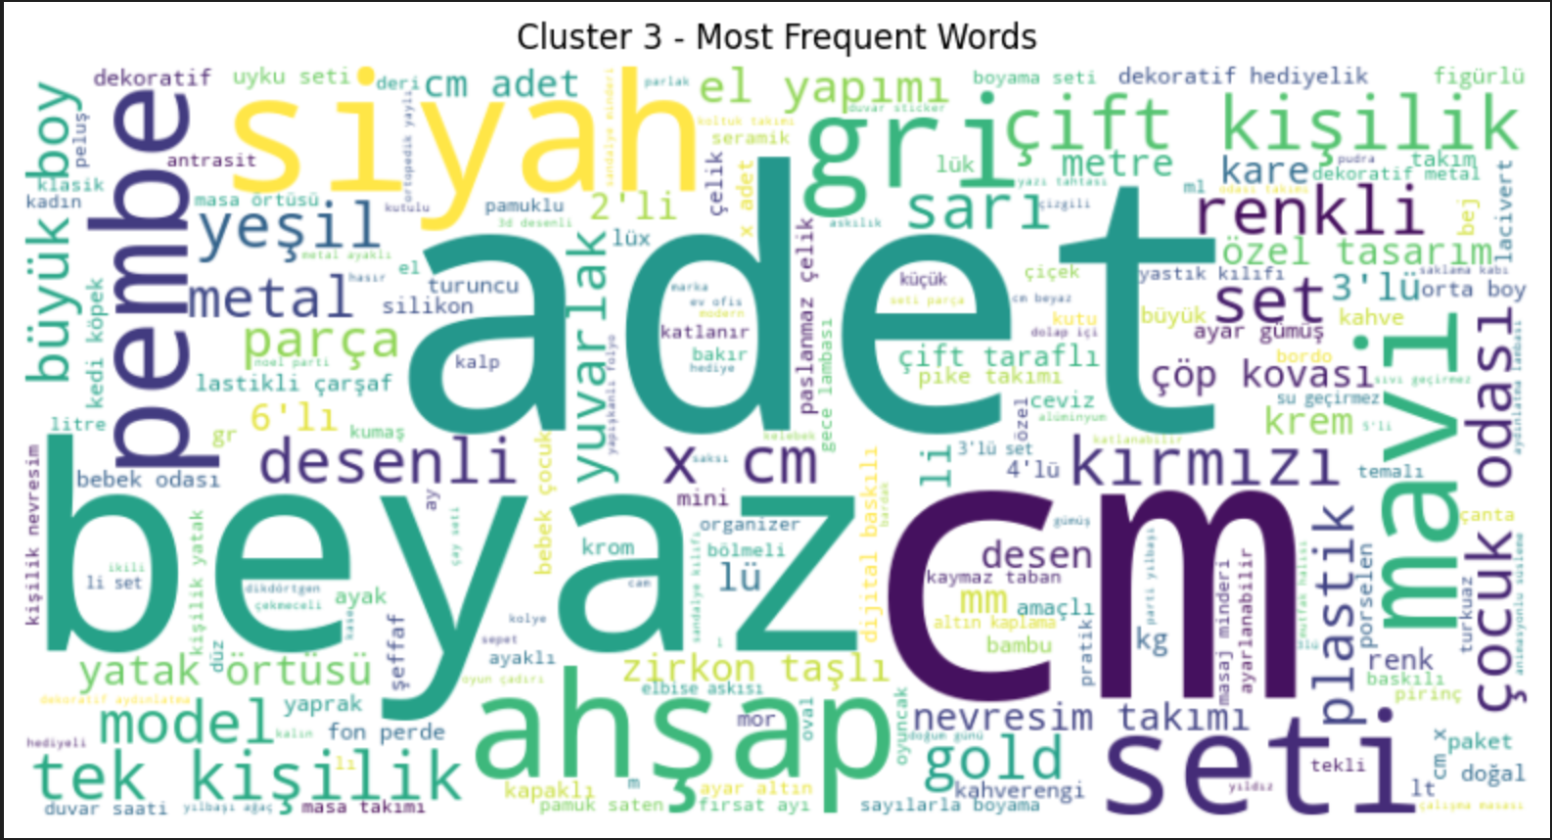
Cluster Examination
Tf-idf top 20:
cm, adet, seti, beyaz, ahşap, dekoratif, takımı, kişilik, bebek, desenli, çift, metal, siyah, set, li, çocuk, lü, renk, yatak, mutfak
My category idea for cluster 3: Yapı Market / Ev / Mobilya

Slide 25
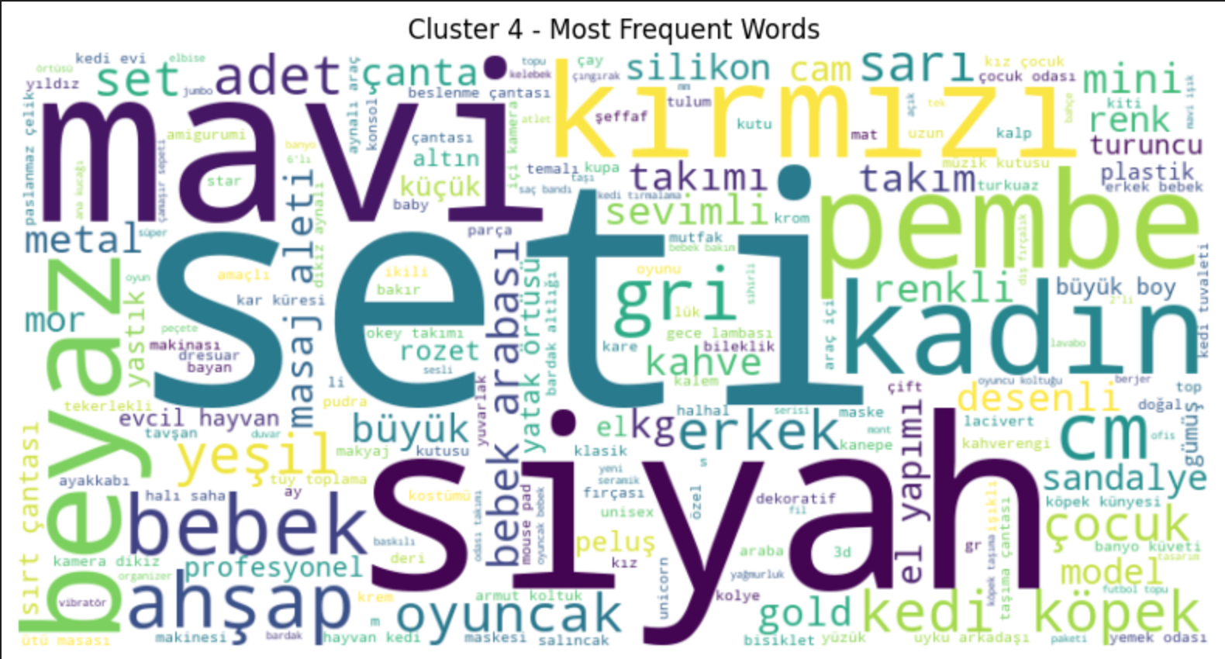
Cluster Examination
Tf-idf top 20:
bebek, kedi, seti, köpek, oyuncak, çantası, çocuk, kadın, pembe, mavi, erkek, takımı, ahşap, siyah, kırmızı, beyaz, oyun, cm, yeşil, gri
My category idea for cluster 4: Bebek/Çocuk

Slide 26
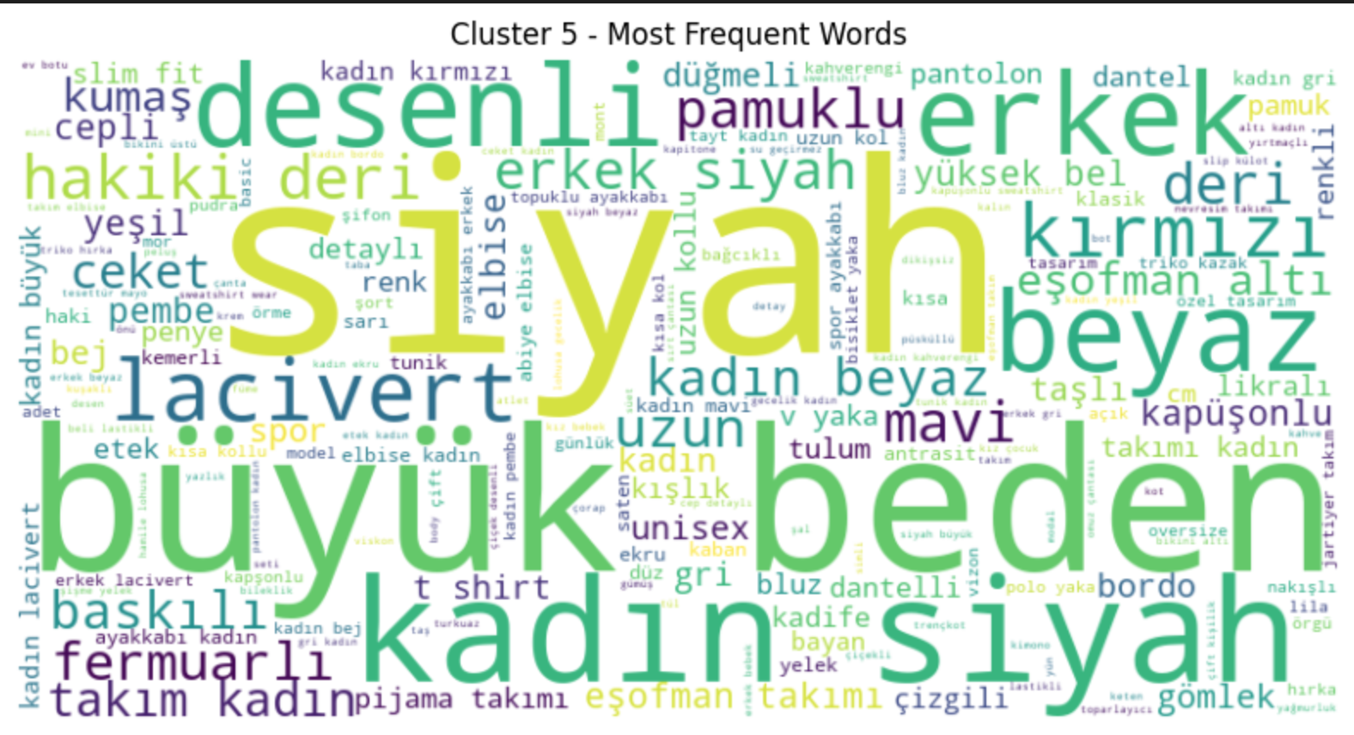
Cluster Examination
Tf-idf top 20:
kadın, siyah, erkek, beden, büyük, takım, detaylı, yaka, deri, ayakkabı, desenli, elbise, beyaz, uzun, lacivert, takımı, eşofman, gri, pantolon, bel
My category idea for cluster 5: Giyim

